Slide 1
Line Blockage Plans (List View)
Index based on Line of Route

Slide 2
Woking
Plan 20 | Woking - Guildford Portsmouth Direct
20.1 | Both lines blocked | ✔
20.2 | One line blocked

Slide 3
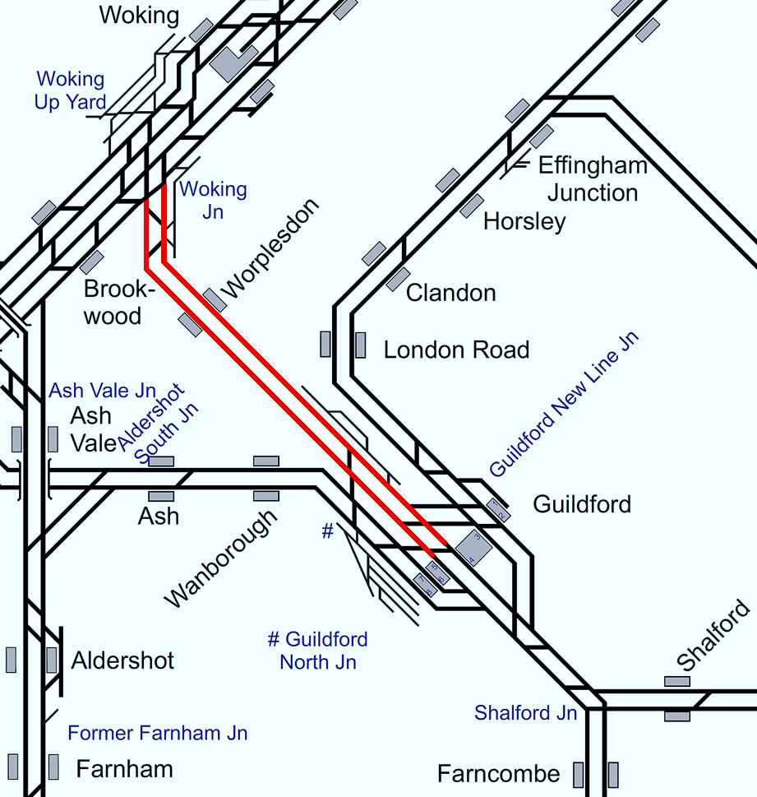
Plan 20.1 Woking - Guildford
Portsmouth Direct | Status: Both lines blocked
Principles of Service Alteration
Off Peak 1Pxx xx.00 Waterloo – Haslemere & xx,02 return. Services Cancelled 1Pxx xx.30 Waterloo - Portsmouth Harbour & xx.45 return services run via Cobham. 2Pxx xx.45 Waterloo - Portsmouth & Southsea / Harbour & xx.18/24 return services run via Cobham Peak 1Pxx xx.00 Waterloo – Portsmouth Hbr & xx,02 return. Services Run via Cobham 1G/2Pxx xx.15 Waterloo – Portsmouth Hbr – Sevices Cancelled and stock run ECS via Eastleigh if crew have route knowledge 1Pxx xx.30 Waterloo - Portsmouth Harbour & xx.45 return services run via Cobham. 2Pxx xx.45 Waterloo - Portsmouth & Southsea / Harbour & xx.18/24 return services run via Cobham
Alternative Passenger Journey
SWR bus replacement Local buses Taxi for Worplesdon
Information for Signallers
See Principles of Service Alteration. Pilot crew via Cobham may be required.
Additional Information for Station Staff
SWR Bus replacement Guildford to Woking and return. Local taxi from Worplesdon station.
Passenger Information
Local buses. Passengers at Guildford for Woking Buses 28,33,34,35,91,462 and 463 (frequent, Journey times vary 37 minutes to 50 minutes) Passengers at Woking for Guildford Buses 28,33,34,35,91,462 and 463 (Frequent Journey times vary 37 minutes to 50 minutes) Passengers at Worplesdon Village to Guildford Bus 28 (Hourly, journey time 18 minutes) to Woking (Hourly, Journey time 37 minutes).

Slide 4
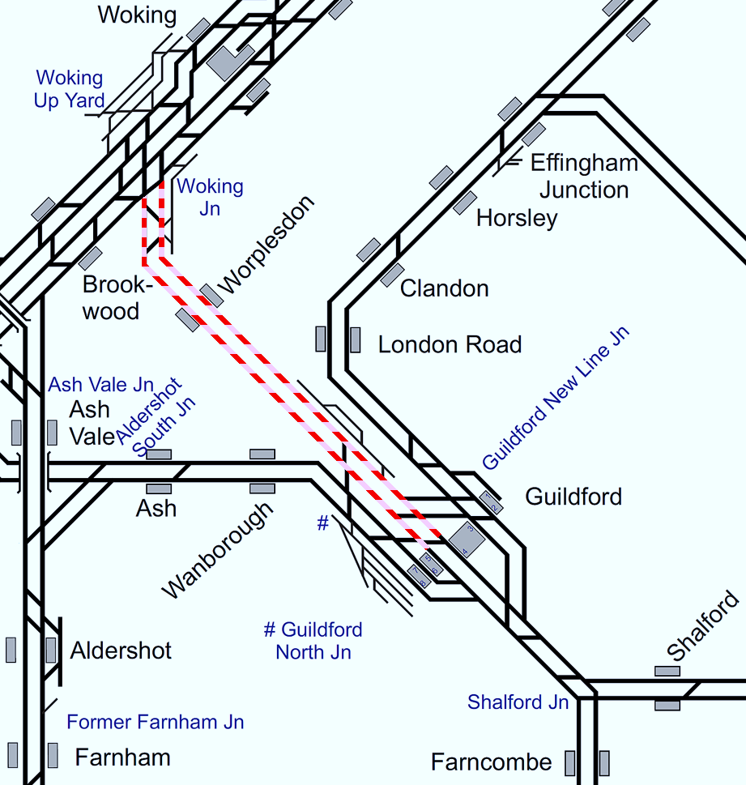
Plan 20.2 Woking - Guildford
Portsmouth Direct | Status: One line blocked (in either direction)
Principles of Service Alteration
Off Peak 1Pxx xx.00 Waterloo – Haslemere & xx.02 return services cancelled 1Pxx xx.30 Waterloo - Portsmouth Harbour & xx.45 return services run via Cobham. 2Pxx xx.45 Waterloo - Portsmouth & Southsea / Harbour & xx.18/24 return services run via Cobham Peak 1Pxx xx.00 Waterloo – Portsmouth & xx.15 return Divert via Eastleigh to balance stock 2Pxx xx.15 Waterloo – Portsmouth & xx.48 return – Cancel and run ECS via Eastleigh 1Pxx xx.30 Waterloo - Portsmouth Harbour & xx.45 return services run via Cobham. 2Pxx xx.45 Waterloo - Portsmouth & Southsea / Harbour & xx.18/24 return services run via Cobham
Alternative Passenger Journey
SWR bus replacement Local buses Taxi from Worplesdon
Information for Signallers
See Principles of Service Alteration. Pilot crew may be required via Cobham in Blocked direction.
Additional Information for Station Staff
SWR Bus replacement Guildford to Woking in blocked direction only. Local taxi from Worplesdon station.
Passenger Information
Local buses. Passengers at Guildford for Woking Buses 28,33,34,35,91,462 and 463 (frequent, Journey times vary 37 minutes to 50 minutes) Passengers at Woking for Guildford Buses 28,33,34,35,91,462 and 463 (Frequent Journey times vary 37 minutes to 50 minutes) Passengers at Worplesdon Village to Guildford Bus 28 (Hourly, journey time 18 minutes) to Woking (Hourly, Journey time 37 minutes).

Slide 5
Guildford
Plan 21 | Guildford - Haslemere Portsmouth Direct
21.1 | Both lines blocked
21.2 | One line blocked | ✔

Slide 6
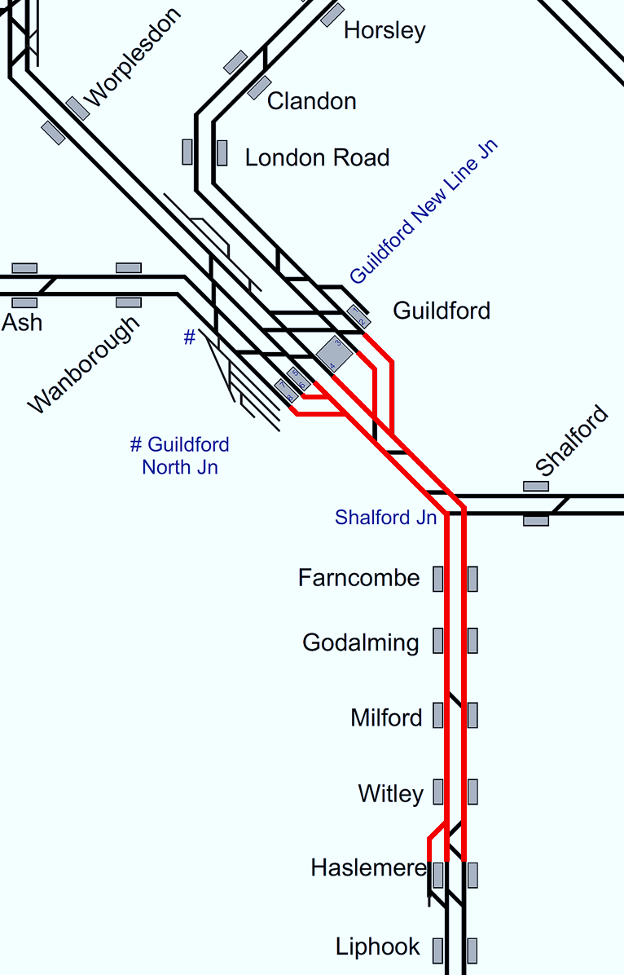
Plan 21.1 Guildford - Haslemere
Portsmouth Direct | Status: Both lines blocked
Principles of Service Alteration
Off Peak 1Pxx xx.00 Waterloo – Haslemere & xx.02 return Start/Terminate at Guildford (SSO Worplesdon) 1Pxx xx.30 Waterloo – Portsmouth Harbour – Divert via Eastleigh 1Pxx xx45 Portsmouth Hbr-Waterloo – Divert via Eastleigh 2Pxx xx.45 Waterloo - Portsmouth & Southsea / Harbour Run from Haslemere to Portsmouth & Southsea 2Pxx.18/24 Portsmouth - Waterloo Run between Portsmouth and Haslemere and return. GWR: If Shalford Junction is blocked, GWR services to run between Reading and Guildford only. Peak 1Pxx xx.00 Waterloo – Portsmouth Harbour & xx return Start/Terminate at Guildford (SSO Worplesdon) 2Pxx xx.15 Waterloo to Portsmouth Harbour – Cancelled throughout 1Pxx xx.30 Waterloo – Portsmouth Harbour – Divert via Eastleigh 1Pxx xx45 Portsmouth Hbr-Waterloo – Divert via Eastleigh 2Pxx xx.45 Waterloo - Portsmouth & Southsea / Harbour Run from Haslemere to Portsmouth & Southsea 2Pxx.18/24 Portsmouth - Waterloo Run between Portsmouth and Haslemere and return. 2Pxx.45/54 Portsmouth - Waterloo Cancelled throughout
Alternative Passenger Journey
Local buses SWR Bus Replacement Guildford - Haslemere all stations
Information for Signallers
See Principles of Service Alteration.
Additional Information for Station Staff
SWR Bus replacement all stations Guildford to Haslemere, fast bus Guildford to Haslemere.
Passenger Information
Local buses. Passengers from Guildford to Farncombe bus 42/46 (infrequent, journey time 11 minutes) Passengers from Guildford to Godalming bus 42/46/70/71/72 (half hourly 21 minutes) Passengers from Milford to Guildford 70,71,503,523 Passengers from Witley for Haslemere, Milford, Godalming Passengers from Haslemere to Witley, Milford, Godalming, Farncombe and Guildford (70,71 buses Hourly, 50 minutes HSL-GLD).

Slide 7
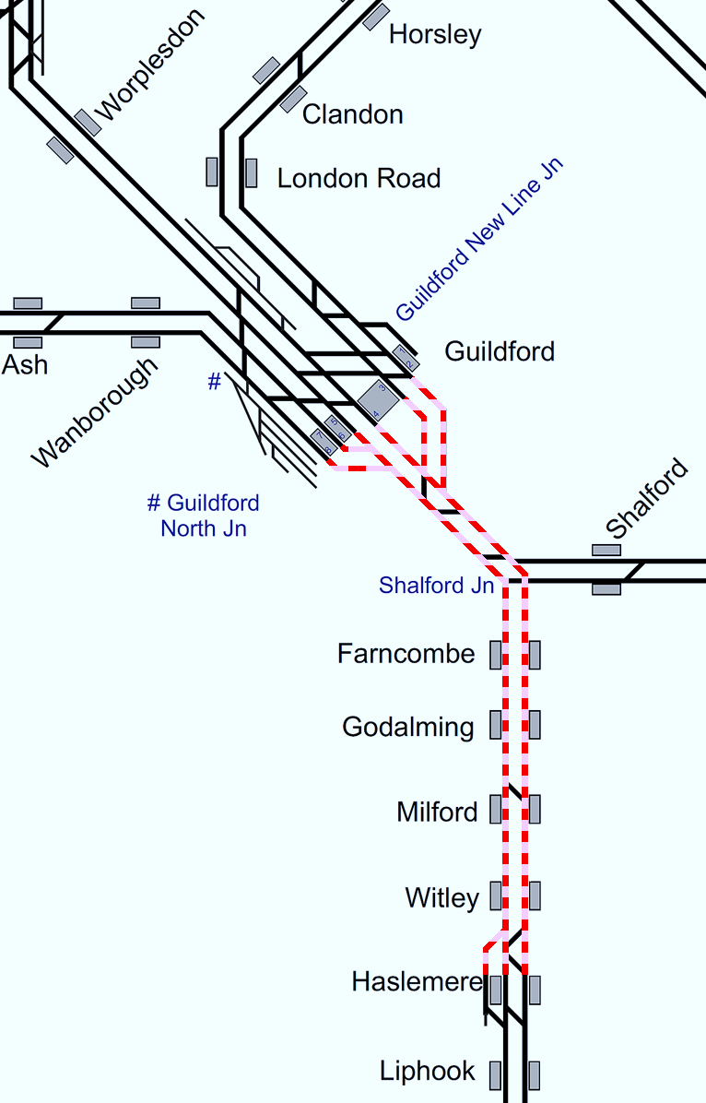
Plan 21.2 Guildford - Haslemere
Portsmouth Direct | Status: One line blocked (in either direction)
Principles of Service Alteration
Off Peak 1Pxx xx.00 Waterloo – Haslemere & xx.02 return services run between Waterloo and Guildford (SSO Worplesdon) 1Pxx xx.30 Waterloo - Portsmouth Harbour & xx.45 return services run via Eastleigh in affected direction. 2Pxx xx.45 Waterloo - Portsmouth & Southsea / Harbour & xx.18/24 run services run between Haslemere and Portsmouth only GWR: If Shalford Junction is blocked, GWR services to run between Reading and Guildford only. Peak 1Pxx xx.00 Waterloo – Portsmouth Hbr & xx.15 return services run between Waterloo and Guildford (SSO Worplesdon) 2Pxx xx.15 Waterloo – Portsmouth (Peak) & xx.54 return Cancelled throughout 1Pxx xx.30 Waterloo - Portsmouth Harbour & xx.47 return services run via Eastleigh in affected direction. 2Pxx xx.45 Waterloo - Portsmouth & Southsea / Harbour & xx.18/24 run services run between Haslemere and Portsmouth only GWR: If Shalford Junction is blocked, GWR services to run between Reading and Guildford only.
Alternative Passenger Journey
Local buses SWR Bus Replacement Guildford - Haslemere in Blocked direction
Information for Signallers
See Principles of Service Alteration.
Additional Information for Station Staff
SWR Bus replacement all stations Guildford to Haslemere, fast bus Guildford to Haslemere.
Passenger Information
Local buses. Passengers from Guildford to Farncombe bus 42/46 (infrequent, journey time 11 minutes) Passengers from Guildford to Godalming bus 42/46/70/71/72 (half hourly 21 minutes) Passengers from Milford to Guildford 70,71,503,523 Passengers from Witley for Haslemere, Milford, Godalming Passengers from Haslemere to Witley, Milford, Godalming, Farncombe and Guildford (70,71 buses Hourly, 50 minutes HSL-GLD).

Slide 8
Haslemere
Plan 22 | Haslemere - Petersfield Portsmouth Direct
22.1 | Both lines blocked | ✔
22.2 | One line blocked (Single Line Working not practicable)

Slide 9
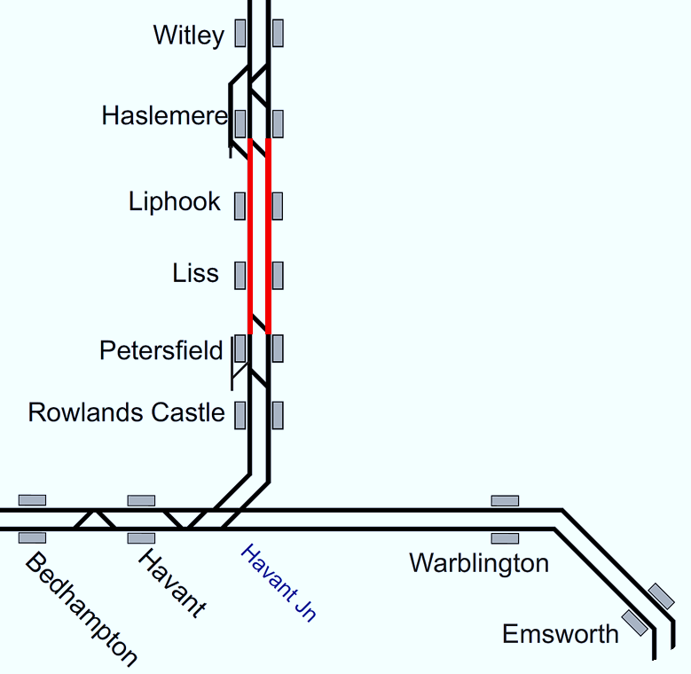
Plan 22.1 Haslemere - Petersfield
Portsmouth Direct | Status: Both lines blocked
Principles of Service Alteration
Off Peak 1Pxx xx.00 Waterloo to Haslemere and xx.02 return SSO Worplesdon, Witley & Milford 1Pxx xx.30 Waterloo to Portsmouth & xx.45 Portsmouth to Waterloo services divert via Eastleigh 2Pxx xx.45 Waterloo to Portsmouth & S –Start at Petersfield. 2Pxx xx.18/24 Portsmouth & Southsea/Harbour to Waterloo Terminate/start Petersfield Peak 1Pxx xx.00 Waterloo - Portsmouth Harbour & xx.15 return Cancelled throughout 2Pxx xx.15 Waterloo - Portsmouth & xx.54 return services (Peaks) services terminate at Haslemere 1Pxx xx.30 Waterloo – Portsmouth & xx.45 Portsmouth - Waterloo services divert via Eastleigh 2Pxx xx.45 Waterloo - Portsmouth & Southsea / Harbour Terminate/start Petersfield 2Pxx xx.18/24 Portsmouth & Southsea/Harbour to Waterloo Terminate/start Petersfield.
Alternative Passenger Journey
SWR Bus service Haslemere to Petersfield. Fast and Slow Bus. Local buses.
Information for Signallers
See Principles of Service Alteration. If 1Pxx xx.00/30 Waterloo to Portsmouth Harbour has departed Guildford, terminate Haslemere and run fast via Woking to Fratton (if crew knowledge allows). If 1Pxx xx.15/45 Portsmouth to Waterloo has passed Portcreek Junction run to Eastleigh via Havant, or via Petersfield if past Havant.
Additional Information for Station Staff
SWR Bus replacement Haslemere to Petersfield, fast bus and slow bus.
Passenger Information
Local buses. Passengers from Liss to Petersfield or Alton bus 38 (5 buses 1st @ 0912 last 1712, journey time 20 minutes to Petersfield and 40 minutes to Alton). Passengers from Liphook to Haslemere bus 13 (5 buses 1st @ 1052 last 1840, 15 minutes). Passengers from Liss to Liphook and return No direct bus service.

Slide 10
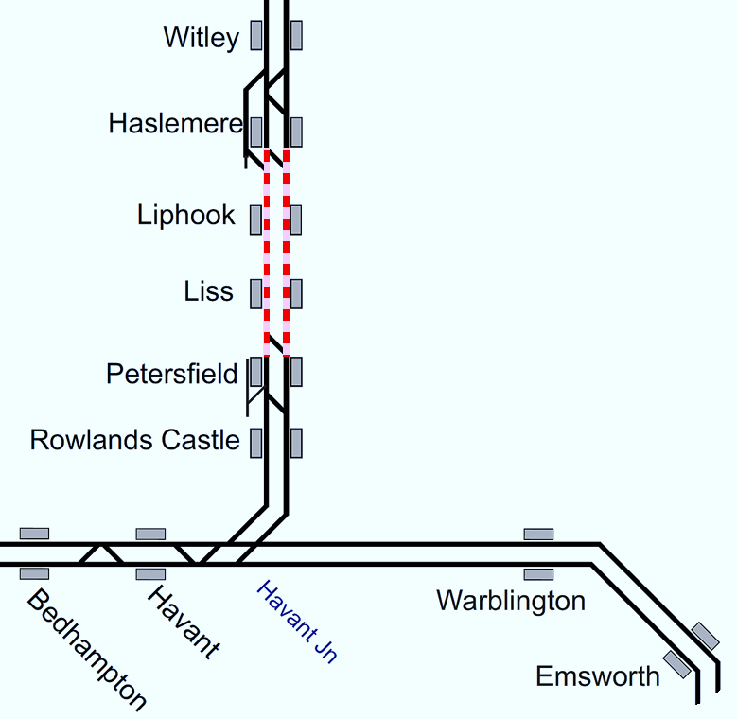
Plan 22.2 Haslemere - Petersfield
Portsmouth Direct | Status: One line blocked (in either direction) Status: (Single Line Working not practicable)
Principles of Service Alteration
Off Peak 1Pxx xx.00 Waterloo to Haslemere and xx.02 return SSO Worplesdon, Witley & Milford 1Pxx xx.30 Waterloo to Portsmouth & xx.45 Portsmouth to Waterloo services divert via Eastleigh in affected direction only 2Pxx xx.45 Waterloo to Portsmouth & S –Start at Petersfield. 2Pxx xx.18/24 Portsmouth & Southsea/Harbour to Waterloo Terminate/start Petersfield Peak 1Pxx xx.00 Waterloo - Portsmouth Harbour & xx.15 return Cancelled throughout 2Pxx xx.15 Waterloo - Portsmouth & xx.54 return services (Peaks) services terminate at Haslemere 1Pxx xx.30 Waterloo – Portsmouth & xx.45 Portsmouth - Waterloo services divert via Eastleigh in affected direction 2Pxx xx.45 Waterloo - Portsmouth & Southsea / Harbour Terminate/start Petersfield 2Pxx xx.18/24 Portsmouth & Southsea/Harbour to Waterloo Terminate/start Petersfield.
Alternative Passenger Journey
SWR Bus service Haslemere to Petersfield. Fast and Slow Bus. Local buses.
Information for Signallers
See Principles of Service Alteration. If 1Pxx xx00 Waterloo to Portsmouth has departed Guildford divert from Haslemere via Woking to Fratton if blocked. If in open direction SSO Liphook and Liss.
Additional Information for Station Staff
SWR Bus replacement Haslemere to Petersfield, fast bus and slow bus.
Passenger Information
Local buses. Passengers from Liss to Petersfield or Alton bus 38 (5 buses 1st @ 0912 last 1712, journey time 20 minutes to Petersfield and 40 minutes to Alton). Passengers from Liphook to Haslemere bus 13 (5 buses 1st @ 1052 last 1840, 15 minutes). Passengers from Liss to Liphook and return No direct bus service.

Slide 11
Petersfield
Plan 23 | Petersfield - Havant Portsmouth Direct
23.1 | Both lines blocked
23.2 | One line blocked (Single Line Working not practicable) | ✔

Slide 12
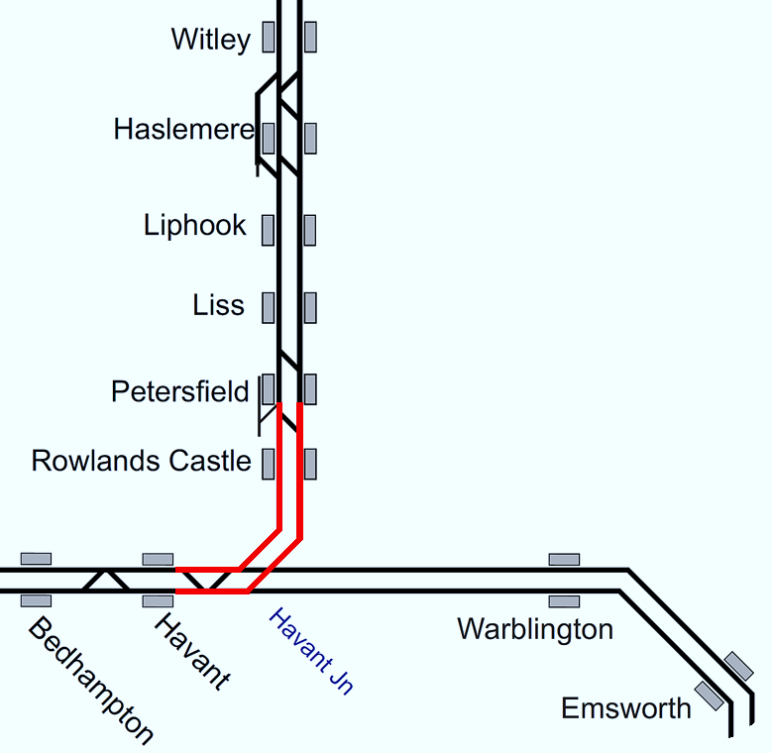
Plan 23.1 Petersfield - Havant
Portsmouth Direct | Status: Both lines blocked
Principles of Service Alteration
Off Peak 1Pxx xx.30 Waterloo - Portsmouth Harbour & xx.45 return divert via Eastleigh. 2Pxx xx.45 Waterloo - Portsmouth & Southsea / Harbour & xx.18/24 return services start/ terminate at Petersfield Peak 1Pxx xx.00 Waterloo - Portsmouth Harbour & xx.15 return Cancelled throughout 2Pxx xx.15 Waterloo - Portsmouth & xx.54 return services Cancelled throughout 1Pxx xx.30 Waterloo – Portsmouth & xx.45 Portsmouth - Waterloo services divert via Eastleigh 2Pxx xx.45 Waterloo - Portsmouth & Southsea / Harbour Terminate Petersfield 2Pxx xx.18/24 Portsmouth & Southsea/Harbour to Waterloo Start Petersfield.
Alternative Passenger Journey
SWR replacement bus. Local bus.
Information for Signallers
See Principles of Service Alteration. If 1Pxx xx00 has departed Guildford Terminate Haslemere and run fast to Fratton, if departed Haslemere call Liphook and Liss terminate Petersfield call Liss, Liphook and Haslemere then fast to Fratton.
Additional Information for Station Staff
1Pxx xx.30 Waterloo - Portsmouth Harbour & xx.45 return services divert via Eastleigh 2Pxx xx.45 Waterloo - Portsmouth & Southsea / Harbour & xx.18/24 return services terminate at Petersfield and restart Up 2Pxx. SWR Bus replacement Fast Bus Havant to Petersfield and slow bus via Rowlands Castle.
Passenger Information
Passengers at Havant for Petersfield bus 37 (1st bus @ 0700 last 1710 hourly, Journey time 78 minutes). Passengers at Petersfield to Havant bus 37 (1st bus @ 0640 last 1840 hourly, Journey time 80 minutes). Passengers at Rowlands Castle for Havant bus 27 (@ 1000,1200,1440,1640. 26 minutes). Passengers at Havant for Rowlands Castle bus 27 (@ 0920,1120,1400,1600. 32 minutes).

Slide 13
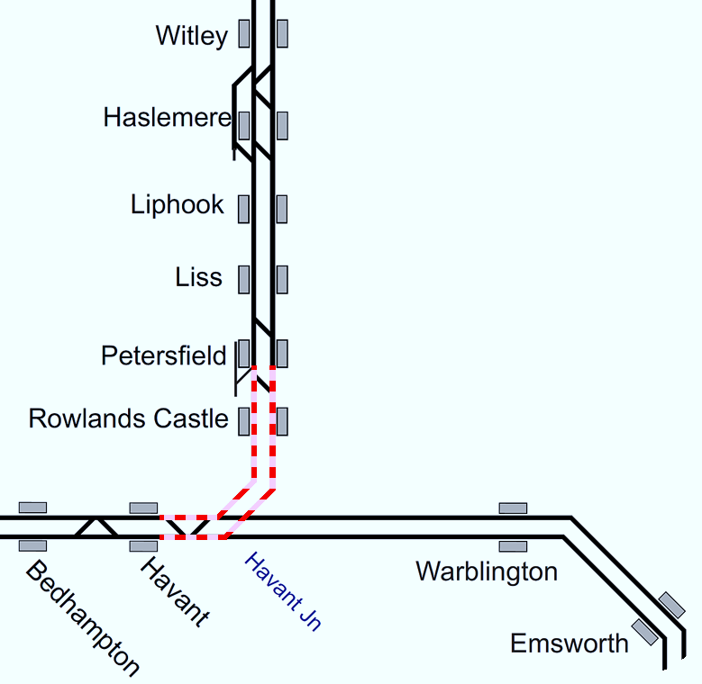
Plan 23.2 Petersfield - Havant
Portsmouth Direct | Status: One line blocked (in either direction) Status: (Single Line Working not practicable)
Principles of Service Alteration
Off Peak 1Pxx xx.30 Waterloo - Portsmouth Harbour & xx.45 return divert via Eastleigh in affected direction 2Pxx xx.45 Waterloo - Portsmouth & Southsea / Harbour & xx.18/24 return services start/ terminate at Petersfield Peak 1Pxx xx.00 Waterloo - Portsmouth Harbour & xx.15 return Cancelled throughout 2Pxx xx.15 Waterloo - Portsmouth & xx.54 return services Cancelled throughout 1Pxx xx.30 Waterloo – Portsmouth & xx.45 Portsmouth - Waterloo services divert via Eastleigh in affected direction 2Pxx xx.45 Waterloo - Portsmouth & Southsea / Harbour Terminate Petersfield 2Pxx xx.18/24 Portsmouth & Southsea/Harbour to Waterloo Start Petersfield.
Alternative Passenger Journey
Local bus. SWR Replacement bus.
Information for Signallers
1Pxx xx.00 Waterloo - Portsmouth Harbour & xx.15 return services cancelled. 1Pxx xx.30 Waterloo - Portsmouth Harbour & xx.45 return Divert via Eastleigh in affected direction 2Pxx xx.45 Waterloo - Portsmouth & Southsea / Harbour & xx.18/24 return services run via Eastleigh in blocked direction. If 1Pxx xx00 has departed Guildford terminate Haslemere and run fast to Fratton, if departed Haslemere call Liphook and Liss terminate Petersfield call Liss, Liphook and Haslemere then fast to Fratton. If blocked direction. As booked in unaffected direction.
Additional Information for Station Staff
SWR Bus replacement Fast Bus Havant to Petersfield and slow bus via Rowlands Castle.
Passenger Information
Passengers at Havant for Petersfield bus 37 (1st bus @ 0700 last 1710 hourly, Journey time 78 minutes). Passengers at Petersfield to Havant bus 37 (1st bus 0640 last 1840 hourly, Journey time 80 minutes). Passengers at Rowlands Castle for Havant bus 27 (@ 1000,1200,1440,1640. 26 minutes). Passengers at Havant for Rowlands Castle bus 27 (@ 0920,1120,1400,1600. 32 minutes).

Slide 14
Havant
Plan24 | Havant - Portcreek Junction Portsmouth Direct
24.1 | Both lines blocked
24.2 | One line blocked

Slide 15
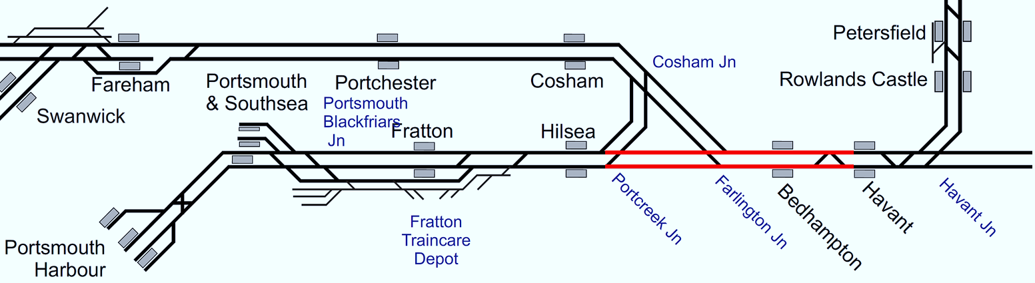
Plan 24.1 Havant - Portcreek Junction
Note: Red line = line blocked, Hatched line = line in either direction could be blocked.
Portsmouth Direct | Status: Both lines blocked
Principles of Service Alteration
SWR Off Peak 1Pxx xx.30 Waterloo - Portsmouth Harbour & xx.45 return services terminate/start back from Havant. 2Pxx xx.45 Waterloo - Portsmouth & Southsea / Harbour & xx.18/24 return services terminate/start back from Havant. SWR Peak 1Pxx xx.00 Waterloo - Portsmouth Harbour & xx.15 return services Cancelled throughout 2Pxx xx.15 Waterloo to Portsmouth & Southsea Terminate at Havant. To form next 2Pxx back from Havant 1Pxx xx.30 Waterloo - Portsmouth Harbour & xx.45 return services Divert via Eastleigh 2Pxx xx.45 Waterloo - Portsmouth & Southsea / Harbour & xx.18/24 return services terminate/start back from Havant forming next 2Pxx service. GTR 1Sxx from Brighton direction terminate/start from Chichester. From Portsmouth direction, stock and crew to remain at Portsmouth to form first Eastbound service or berth. 1C/1J services divert to Bognor. 1Nxx services terminate/start at Barnham with stock and crew to step up by 2 circuits. From Southampton Central, any stock/crew to form shuttle service between Southampton Central and Fareham or berth at Southampton Central Down Bay or Fareham Bay. (SWR Pilot Driver required for berth at SOU). 2Sxx from Littlehampton to terminate at Havant start back early to wait for time at Warblington. GWR 1S91 cancelled. Stock to remain at Fratton CSD and form 1V94 start RT at Cosham ECS from Fratton 1O98 terminate at Fareham and stable in bay to form 1V98 start Fareham
Alternative Passenger Journey
SWR bus replacement Local buses
Information for Signallers
See Principles of Service Alteration.
Additional Information for Station Staff
SWR bus replacement to Portsmouth Harbour Fast bus calling at Portsmouth & Southsea. Slow bus calling all stations, including Cosham at Havant.
Passenger Information
Local buses. Passengers from Havant to/from Fratton 21 (every 10 minutes journey 71 minutes). Passengers from Havant to/from Portsmouth city centre and Harbour 20/21/23/700 (every 5 minutes, Journey times 36 minutes to 71 minutes. Passenger from Havant to/from Cosham 20 every 30 mins time 53 /23 Every 10 minutes Time 17 minutes. Passengers from Havant to/from Hilsea 21 every 10 minutes journey 65. Passengers From Havant to/from Bedhampton 23 every 10 minutes 30 minutes journey.

Slide 16
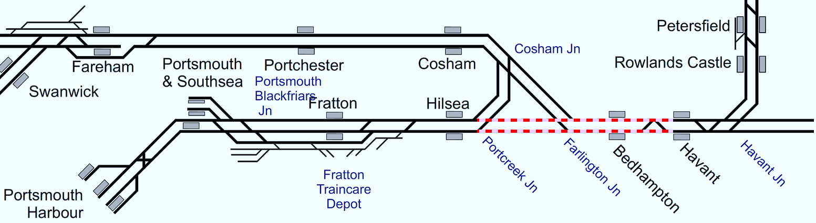
Plan 24.2 Havant - Portcreek Junction
Note: Red line = line blocked, Hatched line = line in either direction could be blocked.
Portsmouth Direct | Status: One line blocked (in either direction)
Principles of Service Alteration
SWR Off Peak 1Pxx xx.30 Waterloo - Portsmouth Harbour & xx.45 return services terminate/start back from Havant. 2Pxx xx.45 Waterloo - Portsmouth & Southsea / Harbour & xx.18/24 return services terminate/start back from Havant. SWR Peak 1Pxx xx.00 Waterloo - Portsmouth Harbour & xx.15 return services Cancelled throughout 2Pxx xx.15 Waterloo to Portsmouth & Southsea Terminate at Havant. To form next 2Pxx back from Havant 1Pxx xx.30 Waterloo - Portsmouth Harbour & xx.45 return services Divert via Eastleigh 2Pxx xx.45 Waterloo - Portsmouth & Southsea / Harbour & xx.18/24 return services terminate/start back from Havant forming next 2Pxx service. GTR 1Sxx from Brighton direction terminate/start from Chichester. From Portsmouth direction, stock and crew to remain at Portsmouth to form first Eastbound service or berth. 1C/1J services divert to Bognor. 1Nxx services terminate/start at Barnham with stock and crew to step up by 2 circuits. From Southampton Central, any stock/crew to form shuttle service between Southampton Central and Fareham or berth at Southampton Central Down Bay or Fareham Bay. (SWR Pilot Driver required for berth at SOU). 2Sxx from Littlehampton to terminate at Havant start back early to wait for time at Warblington. GWR 1S91 cancelled. Stock to remain at Fratton CSD and form 1V94 start RT at Cosham ECS from Fratton 1O98 terminate at Fareham and stable in bay to form 1V98 start Fareham
Alternative Passenger Journey
SWR bus replacement. Local buses.
Information for Signallers
See Principles of Service Alteration.
Additional Information for Station Staff
SWR bus replacement to Portsmouth Harbour Fast bus calling at Portsmouth & Southsea. Slow bus calling all stations, including Cosham at Havant.
Passenger Information
Local buses. Passengers from Havant to/from Fratton 21 (every 10 minutes journey 71 minutes) Passengers from Havant to/from Portsmouth city centre and Harbour 20/21/23/700 (every 5 minutes, Journey times 36 minutes to 71 minutes Passenger from Havant to/from Cosham 20 every 30 mins time 53 /23 Every 10 minutes Time 17 minutes. Passengers from Havant to/from Hilsea 21 every 10 minutes journey 65. Passengers From Havant to/from Bedhampton 23 every 10 minutes 30 minutes journey.

Slide 17
Portcreek Junction
Plan 25 | Portcreek Junction - Fratton Portsmouth Direct
25.1 | One or both lines blocked | ✔

Slide 18
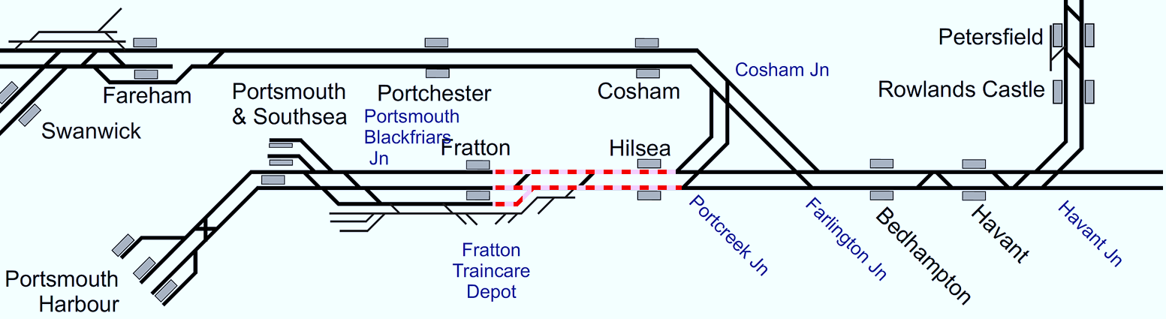
Plan 25.1 Portcreek Junction - Fratton
Note: Red line = line blocked, Hatched line = line in either direction could be blocked.
Portsmouth Direct | Status: One or both lines blocked
Principles of Service Alteration
SWR Off Peak 1Pxx xx.30 Waterloo - Portsmouth Harbour & xx.45 return services terminate/start back from Havant and form next 1Pxx return. 2Pxx xx.45 Waterloo - Portsmouth & Southsea / Harbour & xx.18/24 return services terminate/start back from Havant and form next 2Pxx back SWR Peak 1Pxx xx.00 Waterloo - Portsmouth Harbour & xx.15 return services Cancelled throughout 1G/2Pxx xx.15 Waterloo to Portsmouth & Southsea Cancelled throughout. 1Pxx xx.30 Waterloo - Portsmouth Harbour & xx.45 return services terminate/start back from Havant and form next 1Pxx return. terminate/start back from Havant and form next 1Pxx return.1G/2Pxx xx.45 Waterloo - Portsmouth & Southsea / Harbour & xx.18/24 return services terminate/start back from Havant forming next 2Pxx service. 1Gxx divert via Woking calling at Woking and Worplesdon as per Off Peak service SWR All Day 2Exx Southampton Central to Portsmouth cancelled throughout. Request GTR for SSOs to cover stops. 1Txx xx.09 Waterloo - Portsmouth (EH) & xx.51 return services run between Waterloo and Eastleigh. GTR 1Sxx from Brighton direction terminate/start from Chichester. From Portsmouth direction, stock and crew to remain at Portsmouth to form first Eastbound service or berth. 1C/1J services divert to Bognor. 2Sxx from Littlehampton to terminate at Havant start back early to wait for time at Warblington. GWR: Services to terminate / start at either Fareham or Southampton Central.
Alternative Passenger Journey
Local buses. SWR Bus replacement.
Information for Signallers
See Principles of Service Alteration.
Additional Information for Station Staff
SWR bus replacement Havant to Portsmouth Harbour Fast bus calling at Portsmouth & Southsea. Slow bus calling all stations, including Cosham at Havant. Slow and Fast bus Fareham to Portsmouth Harbour.
Passenger Information
Local buses. Passengers from Havant to/from Fratton 21 (every 10 minutes journey 71 minutes). Passengers from Havant to/from Portsmouth city centre and Harbour 20/21/23/700 (every 5 minutes, Journey times 36 minutes to 71 minutes Passenger from Havant to/from Cosham 20 every 30 mins time 53 /23 Every 10 minutes Time 17 minutes. Passengers from Havant to/from Hilsea 21 every 10 minutes journey 65. Passengers From Havant to/from Bedhampton 23 every 10 minutes 30 minutes journey.

Slide 19
Fratton
Plan 26 | Fratton - Portsmouth & Southsea Portsmouth Direct
26.1 | All lines blocked
26.2 | One line blocked

Slide 20
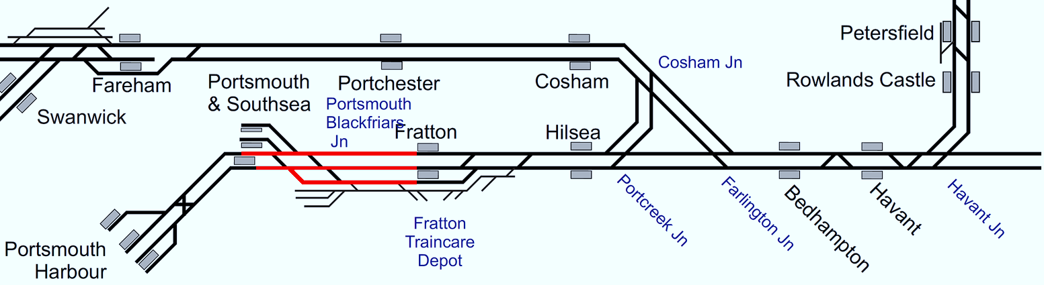
Plan 26.1 Fratton - Portsmouth & Southsea
Note: Red line = line blocked, Hatched line = line in either direction could be blocked.
Portsmouth Direct | Status: All lines blocked
Principles of Service Alteration
SWR Off Peak 1Pxx xx.30 Waterloo - Portsmouth Harbour & xx.45 return services terminate/start back from Fratton 2Pxx xx.45 Waterloo - Portsmouth & Southsea / Harbour & xx.18/24 return services terminate/start back from Fratton SWR Peak 1Pxx xx.00 Waterloo - Portsmouth Harbour & xx.15 return services Cancelled throughout 1G/2Pxx xx.15 Waterloo to Portsmouth & Southsea Cancelled throughout. 1Pxx xx.30 Waterloo - Portsmouth Harbour & xx.45 return services Terminate/start back from Fratton 1G/2Pxx xx.45 Waterloo - Portsmouth & Southsea / Harbour & xx.18/24 return services terminate/start back from Fratton. 1Gxx divert via Woking calling at Woking and Worplesdon as per Off Peak service SWR All Day 2Exx Southampton Central to Portsmouth terminate at Fratton and step up to next 2Exx departure (5 min turnaround) 1Txx xx.09 Waterloo - Portsmouth (EH) & xx.51 return Terminate/Start back from Fratton. Consider stepping up stock to form next SWR departure at Fratton to minimise platform occupancy at Fratton GTR: 1Jxx services terminate / start at Fratton. GTR: 1Sxx from Brighton direction terminate/start from Chichester. From Portsmouth direction, stock and crew to remain at Portsmouth to form first Eastbound service or berth. GTR: 2Sxx from Littlehampton to terminate at Havant start back early to wait for time at Warblington. GWR: Services to terminate / start at Fratton with additional stops requested to GWR for Hilsea and Portchester. Control discuss with GWR crew requirements.
Alternative Passenger Journey
Local buses. SWR Bus replacement.
Information for Signallers
1Pxx xx.00/30 Waterloo - Portsmouth Hbr & xx.15/45 Portsmouth - Waterloo Terminate/Start Fratton. 2Pxx xx.45 Waterloo - Portsmouth & Southsea / Harbour & xx.18/24 return services run between Waterloo and Havant. (Shunt on arrival - arrive xx.26, depart xx.41). 2Exx xx.42 Southampton - Portsmouth & Southsea & xx.36 return services Terminate/start Fratton (3 min turnround at Fratton). 1Txx xx.09 Waterloo - Portsmouth (EH) & xx.51 return Terminate/start Fareham.
Additional Information for Station Staff
1Pxx services call additionally Bedhampton & Hilsea SWR bus replacement Fratton to Portsmouth Hbr & return Fareham to Portsmouth Hbr
Passenger Information
Local buses. Passengers from Fratton to Portsmouth city centre and Harbour bus 1,21 (every 10 minutes journey 7 minutes and 12 minutes). Passengers from Portsmouth and Southsea to Harbour 1,2,3,8,15,20,21,23, 700 (every 2-3 minutes, Journey times 3 minutes.

Slide 21
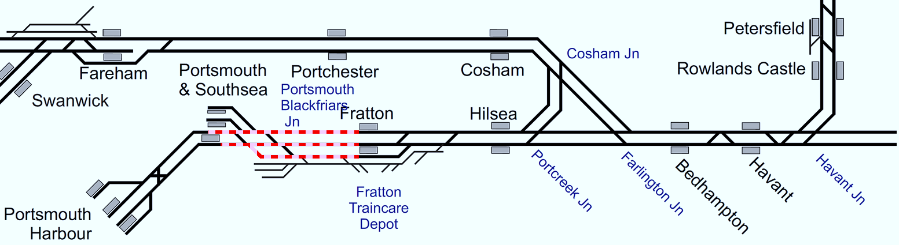
Plan 26.2 Fratton - Portsmouth & Southsea
Note: Red line = line blocked, Hatched line = line in either direction could be blocked.
Portsmouth Direct | Status: One line blocked (in either direction)
Principles of Service Alteration
SWR Off Peak 1Pxx xx.30 Waterloo - Portsmouth Harbour & xx.45 return services terminate/start back from Fratton 2Pxx xx.45 Waterloo - Portsmouth & Southsea / Harbour & xx.18/24 return services terminate/start back from Fratton SWR Peak 1Pxx xx.00 Waterloo - Portsmouth Harbour & xx.15 return services Cancelled throughout 1G/2Pxx xx.15 Waterloo to Portsmouth & Southsea Cancelled throughout. 1Pxx xx.30 Waterloo - Portsmouth Harbour & xx.45 return services Terminate/start back from Fratton 1G/2Pxx xx.45 Waterloo - Portsmouth & Southsea / Harbour & xx.18/24 return services terminate/start back from Fratton. 1Gxx divert via Woking calling at Woking and Worplesdon as per Off Peak service SWR All Day 2Exx Southampton Central to Portsmouth terminate at Fratton and step up to next 2Exx departure (5 min turnaround) 1Txx xx.09 Waterloo - Portsmouth (EH) & xx.51 return Terminate/Start back from Fratton. Consider stepping up stock to form next SWR departure at Fratton to minimise platform occupancy at Fratton GTR: 1Jxx services terminate / start at Fratton. GTR: 1Sxx from Brighton direction terminate/start from Chichester. From Portsmouth direction, stock and crew to remain at Portsmouth to form first Eastbound service or berth. GTR: 2Sxx from Littlehampton to terminate at Havant start back early to wait for time at Warblington. GWR: Services to terminate / start at Fratton with additional stops requested to GWR for Hilsea and Portchester. Control discuss with GWR crew requirements.
Alternative Passenger Journey
Local buses. SWR Bus replacement.
Information for Signallers
1Pxx xx.00/30 Waterloo - Portsmouth Hbr & xx.15/45 Portsmouth - Waterloo Terminate/Start Fratton. 2Pxx xx.45 Waterloo - Portsmouth & Southsea / Harbour & xx.18/24 return services run between Waterloo and Havant. (Shunt on arrival - arrive xx.26, depart xx.41). 2Exx xx.42 Southampton - Portsmouth & Southsea & xx.36 return services Terminate/start Fratton (3 min turnround at Fratton). 1Txx xx.09 Waterloo - Portsmouth (EH) & xx.51 return Terminate/start Fareham.
Additional Information for Station Staff
1Pxx services call additionally Bedhampton & Hilsea. SWR bus replacement. Fratton to Portsmouth Harbour & return. Fareham to Portsmouth Harbour.
Passenger Information
Local buses. Passengers from Fratton to Portsmouth city centre and Harbour bus 1 or 21 (every 10 minutes journey 7 minutes and 12 minutes) Passengers from Portsmouth and Southsea to Harbour 1, 2, 3, 8, 15, 20, 21, 23 and 700 (every 2-3 minutes, Journey times 3 minutes.

Slide 22
Portsmouth & Southsea
Plan 27 | Portsmouth & Southsea - Portsmouth Harbour Portsmouth Direct
27.1 | Both lines blocked | ✔
27.2 | One line blocked | ✔

Slide 23
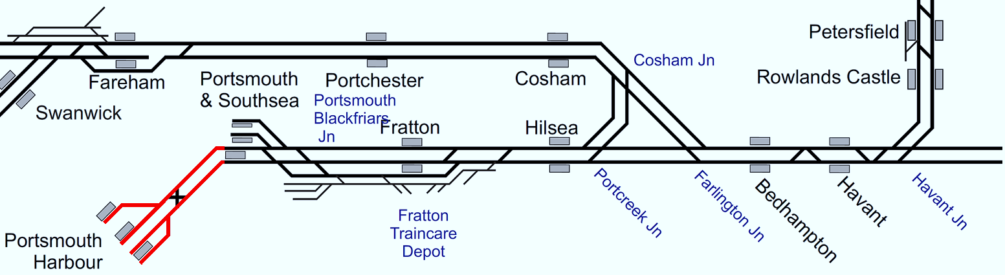
Plan 27.1 Portsmouth & Southsea -
Portsmouth Harbour
Note: Red line = line blocked, Hatched line = line in either direction could be blocked.
Portsmouth Direct | Status: Both lines blocked
Principles of Service Alteration
SWR Off Peak 1Pxx xx.30 Waterloo - Portsmouth Harbour & xx.45 return services terminate/start back from Portsmouth & Southsea 2Pxx xx.45 Waterloo - Portsmouth & Southsea / Harbour & xx.18/24 return services. Terminate/Start back at Portsmouth & Southsea (if booked to Harbour) SWR Peak 1Pxx xx.00 Waterloo - Portsmouth Harbour & xx.15 return services Cancelled throughout 1G/2Pxx xx.15 Waterloo to Portsmouth & Southsea Start/Terminate at Fratton 1Pxx xx.30 Waterloo - Portsmouth Harbour & xx.45 return services Terminate/start back from Portsmouth & Southsea 1G/2Pxx xx.45 Waterloo - Portsmouth & Southsea / Harbour & xx.18/24 return services terminate/start back from Portsmouth & Southsea. 1Gxx divert via Woking calling at Woking and Worplesdon as per Off Peak service SWR All Day 2Exx Southampton Central to Portsmouth terminate at Fratton and step up to next 2Exx departure (5 min turnaround) 1Txx xx.09 Waterloo - Portsmouth (EH) & xx.51 return Terminate/Start back from Fratton and shunt via Back Road/ GTR: 1Jxx services terminate / start at Fratton. GTR: 1Sxx from Brighton direction terminate/start from Chichester. From Portsmouth direction, stock and crew to remain at Portsmouth to form first Eastbound service or berth. GTR: 2Sxx from Littlehampton to terminate at Havant start back early to wait for time at Warblington. GWR: Services to terminate / start at Portsmouth and Southsea or Fratton. Control discuss with GWR crew requirements.
Alternative Passenger Journey
Local bus services.
Information for Signallers
See Principles of Service Alteration.
Additional Information for Station Staff
N/A.
Passenger Information
Local buses. Passengers from Fratton to Portsmouth city centre and Harbour bus 1,21 (every 10 minutes journey 7 minutes and 12 minutes) Passengers from Portsmouth and Southsea to Harbour 1,2,3,8,15,20,21,23, 700 (every 2-3 minutes, Journey times 3 minutes.

Slide 24
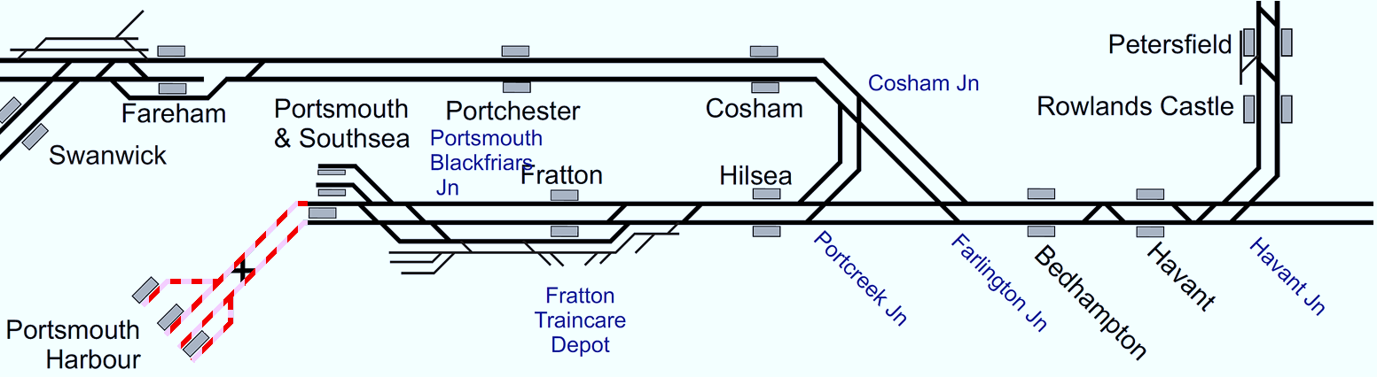
Plan 27.2 Portsmouth & Southsea -
Portsmouth Harbour
Note: Red line = line blocked, Hatched line = line in either direction could be blocked.
Portsmouth Direct | Status: One line blocked (in either direction)
Principles of Service Alteration
SWR Off Peak 1Pxx xx.30 Waterloo - Portsmouth Harbour & xx.45 return services terminate/start back from Portsmouth & Southsea 2Pxx xx.45 Waterloo - Portsmouth & Southsea / Harbour & xx.18/24 return services. Terminate/Start back at Portsmouth & Southsea (if booked to Harbour) SWR Peak 1Pxx xx.00 Waterloo - Portsmouth Harbour & xx.15 return services Cancelled throughout 1G/2Pxx xx.15 Waterloo to Portsmouth & Southsea Start/Terminate at Fratton 1Pxx xx.30 Waterloo - Portsmouth Harbour & xx.45 return services Terminate/start back from Portsmouth & Southsea 1G/2Pxx xx.45 Waterloo - Portsmouth & Southsea / Harbour & xx.18/24 return services terminate/start back from Portsmouth & Southsea. 1Gxx divert via Woking calling at Woking and Worplesdon as per Off Peak service SWR All Day 2Exx Southampton Central to Portsmouth terminate at Fratton and step up to next 2Exx departure (5 min turnaround) 1Txx xx.09 Waterloo - Portsmouth (EH) & xx.51 return Terminate/Start back from Fratton and shunt via Back Road/ GTR: 1Jxx services terminate / start at Fratton. GTR: 1Sxx from Brighton direction terminate/start from Chichester. From Portsmouth direction, stock and crew to remain at Portsmouth to form first Eastbound service or berth. GTR: 2Sxx from Littlehampton to terminate at Havant start back early to wait for time at Warblington. GWR: Services to terminate / start at Portsmouth and Southsea or Fratton. Control discuss with GWR crew requirements.
Alternative Passenger Journey
Local bus services.
Information for Signallers
See Principles of Service Alteration.
Additional Information for Station Staff
N/A.
Passenger Information
Local buses. Passengers from Fratton to Portsmouth city centre and Harbour bus 1,21 (every 10 minutes journey 7 minutes and 12 minutes) Passengers from Portsmouth and Southsea to Harbour 1,2,3,8,15,20,21,23, 700 (every 2-3 minutes, Journey times 3 minutes.

Slide 25
Basingstoke
Plan 34 | Basingstoke - Andover Basingstoke to Laverstock
34.1 | Both lines blocked
34.2 | One line blocked | ✔

Slide 26
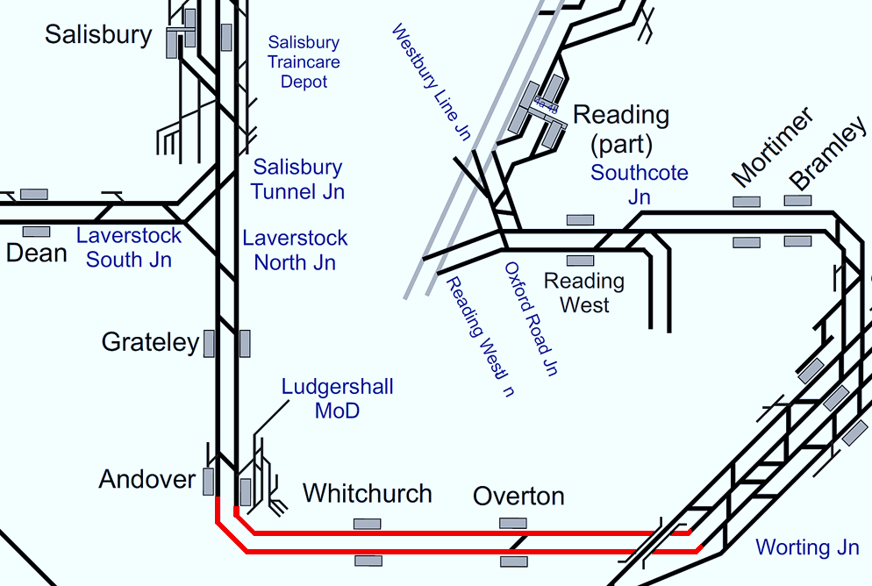
Plan 34.1 Basingstoke - Andover
Basingstoke to Laverstock | Status: Both lines blocked
Principles of Service Alteration
Off Peak 1Lxx xx.20 Waterloo - WoE & return services diverted via Southampton. (Check Crew route knowledge – if Crew do not sign Eastleigh to Basingstoke then terminate at Southampton on Up and return to Salisbury and Basingstoke on Down and shunt to Barton Mill) 1Lxx xx.47 Salisbury to Basingstoke and xx.38 return Start/Terminate at Andover. Peak 1Lxx xx.20 Waterloo - WoE & return services diverted via Southampton. (Check Crew route knowledge – if Crew do not sign Eastleigh to Basingstoke then terminate at Southampton on Up and return to Salisbury and Basingstoke on Down and shunt to Barton Mill) 1Lxx xx,47 Salisbury to Waterloo Terminate Andover 1Lxx xx.50 Waterloo to WoE (Peak) Start Andover. Any trapped services divert via Southampton (Check Crew route knowledge) and terminate at Salisbury. If possible restart portions West of Salisbury if stock and crew available and run RT from Salisbury
Alternative Passenger Journey
If possible, shuttle service between Salisbury and Andover. SWR Fast Bus service between Basingstoke and Andover and Salisbury. SWR Slow Bus Service all stations Basingstoke to Salisbury. Local buses.
Information for Signallers
If 1Lxx all stations to Waterloo Up service trapped after Laverstock Junction terminate Andover and run back to Salisbury. If 1Lxx WoE to Waterloo run back via Romsey to Waterloo (If crew knowledge allows) if no crew knowledge of route return to Salisbury. Pilot drivers may be required Salisbury - Southampton Central or Southampton Central to Basingstoke.
Additional Information for Station Staff
Passengers for stations from Basingstoke to Overton, Whitchurch Andover Grateley to use Bus Replacement, Bus to run all stations Basingstoke to Salisbury and return.
Passenger Information
Local buses. Passengers at Overton for Basingstoke, Whitchurch and Andover 15 minute walk then 76 bus (Overton to Whitchurch 10 minutes, Overton to Andover 26 minutes) Passengers at Basingstoke (bus top X) for Overton, Whitchurch and Andover (1st bus @ 0657 then hourly, Journey 33 minutes to Overton, 55 minutes for Whitchurch and 63 minutes for Andover).

Slide 27
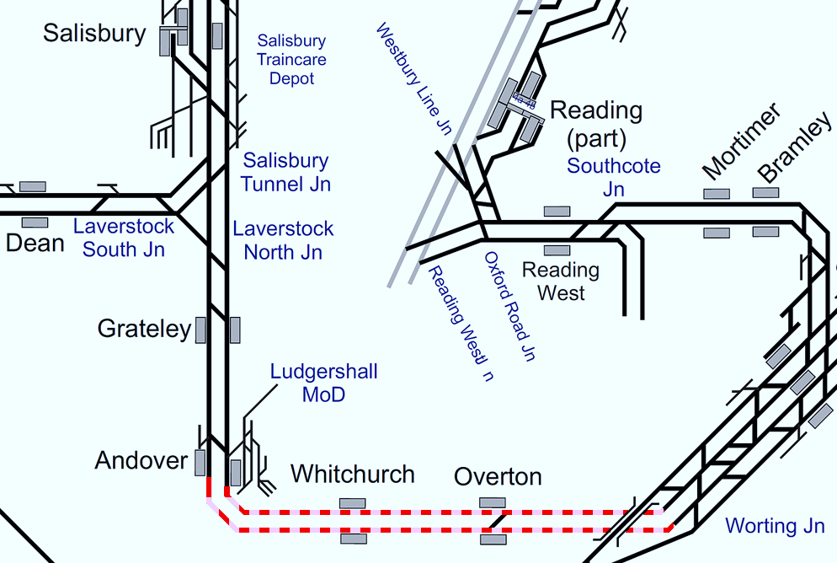
Plan 34.2 Basingstoke - Andover
Basingstoke to Laverstock | Status: One line blocked (in either direction)
Principles of Service Alteration
Off Peak 1Lxx xx.20 Waterloo - WoE & return services diverted via Southampton in blocked direction. Trains to call additionally at Whitchurch and Overton in open direction (Check Crew route knowledge – if Crew do not sign Eastleigh to Basingstoke then terminate at Southampton on Up and return to Salisbury and Basingstoke on Down and shunt to Barton Mill) 1Lxx xx.47 Salisbury to Basingstoke and xx.38 return Terminate/Start at Andover. If service continues West of Salisbury start RT if crew and stock available Peak 1Lxx xx.20 Waterloo - WoE & return services diverted via Southampton in blocked direction. Trains to call all stations Basingstoke to Salisbury in open direction (Check Crew route knowledge – if Crew do not sign Eastleigh to Basingstoke then terminate at Southampton on Up and return to Salisbury and Basingstoke on Down and shunt to Barton Mill) 1Lxx xx,47 Salisbury to Waterloo Terminate at Andover 1Lxx xx.50 Waterloo to WoE (Peak) Start at Andover. Any trapped services divert via Southampton (Check Crew route knowledge) and terminate at Salisbury. If possible restart portions West of Salisbury if stock and crew available and run RT from Salisbury
Alternative Passenger Journey
Bus replacement to run in Blocked direction all stations Basingstoke to Salisbury.
Information for Signallers
If 1Lxx all stations to Waterloo Up service trapped after Laverstock Junction terminate Andover and run back to Salisbury. If 1Lxx WoE to Waterloo run back via Romsey to Waterloo (If crew knowledge allows) if no crew knowledge of route return to Salisbury. Pilot drivers may be required Salisbury - Southampton Central or Southampton Central to Basingstoke.
Additional Information for Station Staff
Passengers for Stations from Basingstoke to Overton, Whitchurch Andover Grateley to use Bus Replacement, Bus to run all stations Basingstoke to Salisbury in Blocked direction. 1Lxx xx.20 WoE services to call additionally all stations Basingstoke to Salisbury via Andover. Basingstoke SCP (if Up Line Open) or Salisbury SCP (if Down line Open) to issue Stop Orders.
Passenger Information
Local buses. Passengers at Overton for Basingstoke, Whitchurch and Andover 15 minute walk then 76 bus (Overton to Whitchurch 10 minutes, Overton to Andover 26 minutes) Passengers at Basingstoke (bus top X) for Overton, Whitchurch and Andover (1st bus 0657 then hourly, Journey 33 minutes to Overton, 55 minutes for Whitchurch and 63 minutes for Andover).

Slide 28
Andover
Plan 35 | Andover - Laverstock North Junction Basingstoke to Laverstock
35.1 | Both lines blocked
35.2 | One line blocked

Slide 29
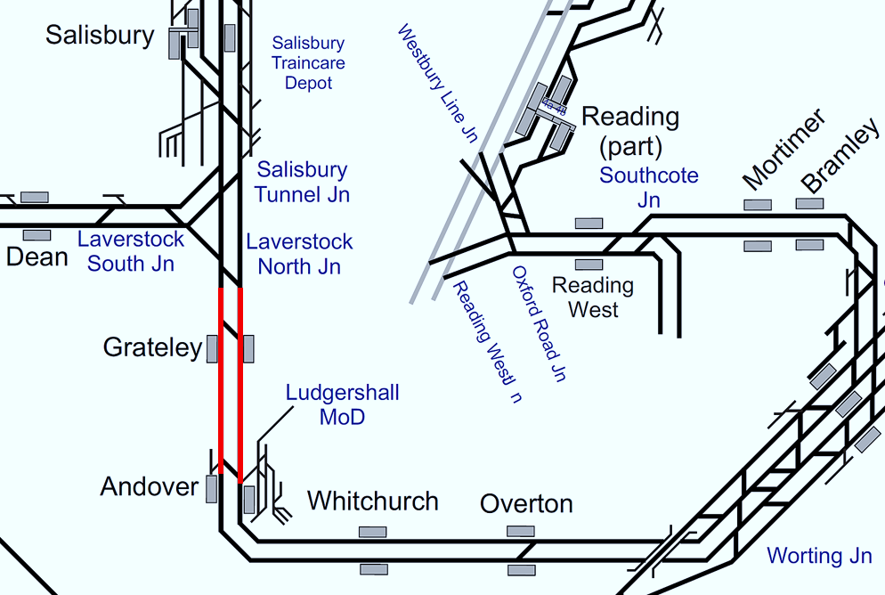
Plan 35.1 Andover - Laverstock North Junction
Basingstoke to Laverstock | Status: Both lines blocked
Principles of Service Alteration
Off Peak 1Lxx xx.20 Waterloo - WoE & return services diverted via Southampton. (Check Crew route knowledge – if Crew do not sign Eastleigh to Basingstoke then terminate at Southampton on Up and return to Salisbury and Basingstoke on Down and shunt to Barton Mill) 1Lxx xx.47 Salisbury to Basingstoke and xx.38 return Start/Terminate at Andover Crew permitting Peak 1Lxx xx.20 Waterloo - WoE & return services diverted via Southampton. (Check Crew route knowledge – if Crew do not sign Eastleigh to Basingstoke then terminate at Southampton on Up and return to Salisbury and Basingstoke on Down and shunt to Barton Mill) 1Lxx xx,47 Salisbury to Waterloo Cancelled if still at Salisbury. 1Lxx xx.50 Waterloo to WoE (Peak). Any trapped services divert via Southampton (Check Crew route knowledge) and terminate at Salisbury. If Crew available use stock stabled at Barton Mill to run shuttle Basingstoke to Andover. If possible restart portions West of Salisbury if stock and crew available and run RT from Salisbury
Alternative Passenger Journey
SWR Bus to run Andover to Salisbury and return.
Information for Signallers
If 1Lxx xx.20 Waterloo to Exeter St Davids trapped Run back to Basingstoke and Divert via Southampton Central. Up service divert via Southampton Central. Pilot drivers may be required Salisbury - Southampton Central or Southampton Central to Basingstoke.
Additional Information for Station Staff
Passengers for Grateley change to SWR Bus at Andover or Salisbury 1Lxx xx.20 Waterloo to Exeter St Davids and return via will divert Southampton Central. 1Lxx xx.50 Waterloo to Salisbury and return Terminates Andover.
Passenger Information
Local buses. Passengers at Andover for Grateley Bus 5 1st bus 0705 5 buses last 1625 (33 minutes) Bus 77 4 buses @ 0945,1045,1310,1555 journey 10 minutes. Passengers at Andover for Salisbury ever 30 minutes journey time 84 minutes.

Slide 30
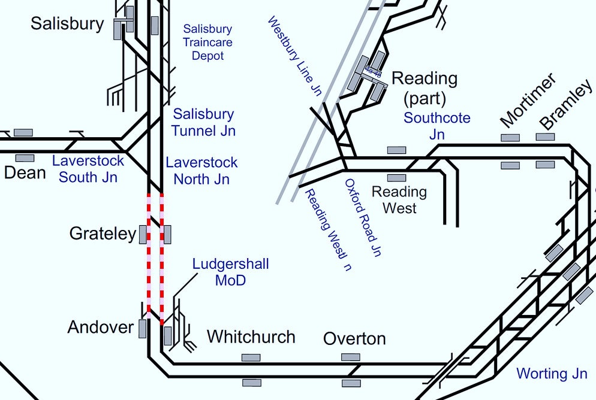
Plan 35.2 Andover - Laverstock North Junction
Basingstoke to Laverstock | Status: One line blocked (in either direction)
Principles of Service Alteration
Off Peak 1Lxx xx.20 Waterloo - WoE & return services diverted via Southampton in blocked direction. Trains to call additionally at Grateley in open direction (Check Crew route knowledge – if Crew do not sign Eastleigh to Basingstoke then terminate at Southampton on Up and return to Salisbury and Basingstoke on Down and shunt to Barton Mill) 1Lxx xx.47 Salisbury to Basingstoke and xx.38 return Start/Terminate at Andover. If service continues West of Salisbury start RT if crew and stock available Peak 1Lxx xx.20 Waterloo - WoE & return services diverted via Southampton in blocked direction. Trains to call additionally at Grateley in open direction (Check Crew route knowledge – if Crew do not sign Eastleigh to Basingstoke then terminate at Southampton on Up and return to Salisbury and Basingstoke on Down and shunt to Barton Mill) 1Lxx xx,47 Salisbury to Waterloo Cancelled if still at Salisbury. 1Lxx xx.50 Waterloo to WoE (Peak). Any trapped services divert via Southampton (Check Crew route knowledge) and terminate at Salisbury. If Crew available use stock stabled at Barton Mill to run shuttle Basingstoke to Andover. If possible restart portions West of Salisbury if stock and crew available and run RT from Salisbury
Alternative Passenger Journey
SWR Bus to run Andover to Salisbury and return. 1Lxx xx.20 Waterloo to Exeter St Davids or Return SSO Grateley in Open direction.
Information for Signallers
If 1Lxx xx.20 Waterloo to Exeter St Davids trapped Run back to Basingstoke and divert via Southampton Central. Up service divert via Southampton Central. Pilot drivers may be required Salisbury - Southampton Central or Southampton Central to Basingstoke.
Additional Information for Station Staff
Passengers for Grateley change to SWR Bus at Andover or Salisbury 1Lxx xx.20 Waterloo to Exeter St Davids and return via will divert Southampton Central in Blocked direction and run booked route with SSO Grateley in open direction. 1Lxx xx.50 Waterloo to Salisbury and return Terminates/Start Andover.
Passenger Information
Local buses. Passengers at Andover for Grateley Bus 5 1st bus 0705 5 buses last 1625 (33 minutes) Bus 77 4 buses 0945,1045,1310,1555 journey 10 minutes. Passengers at Andover for Salisbury ever 30 minutes journey time 84 minutes.

Slide 31
Pirbright Junction
Plan 28 | Pirbright Junction - Ash Vale Alton Line
28.1 | Both lines blocked
28.2 | One line blocked | ✔

Slide 32
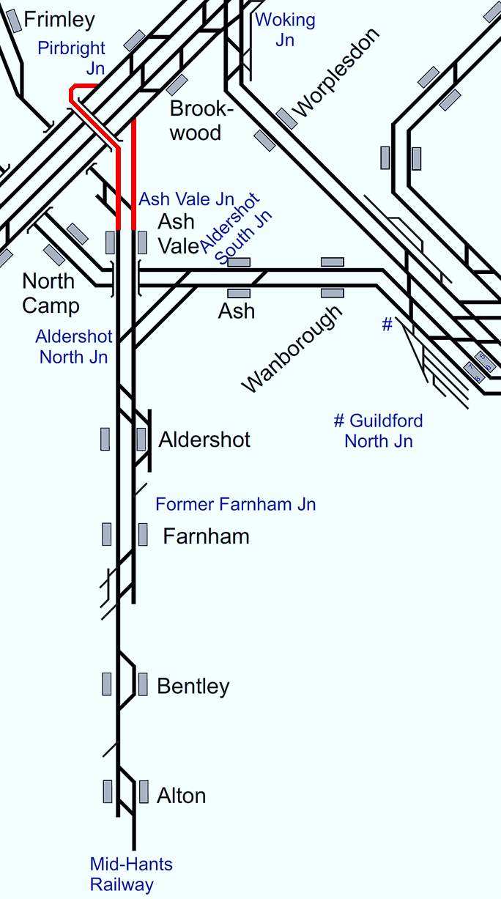
Plan 28.1 Pirbright Junction - Ash Vale
Alton Line | Status: Both lines blocked
Principles of Service Alteration
1Axx xx.23/53 Waterloo - Alton & return services run via Guildford and call all stations to Farnham. 2Jxx Farnham to Guildford and return Cancelled.(Use Crew to pilot 1Axx service crewed by BV/WA/WM) Consider 2Lxx forming 2Lxx services at Waterloo and use BV crew accordingly. Note: BV/WA/WM crews have NO alternative route knowledge. (WA/WM do have route knowledge to Woking to Guildford). If Country side of Block hold in Platforms. If running Down from London consider diverting to Basingstoke. Watch for crew changes at Farnham.
Alternative Passenger Journey
SWR Bus replacement Brookwood to Ash Vale and Aldershot. 1Axx SSO Guildford, Wanborough and Ash in both directions. Use 2Jxx crew as Pilot crew if required.
Information for Signallers
2Jxx cancel and send to Farnham Shed or hold at Guildford. 1Axx run via Guildford and call all stations, may require Pilot crew.
Additional Information for Station Staff
SWR Bus replacement to run Aldershot to Brookwood and return.
Passenger Information
Passengers from Brookwood to travel to Woking for trains to Aldershot and Ash Vale.

Slide 33
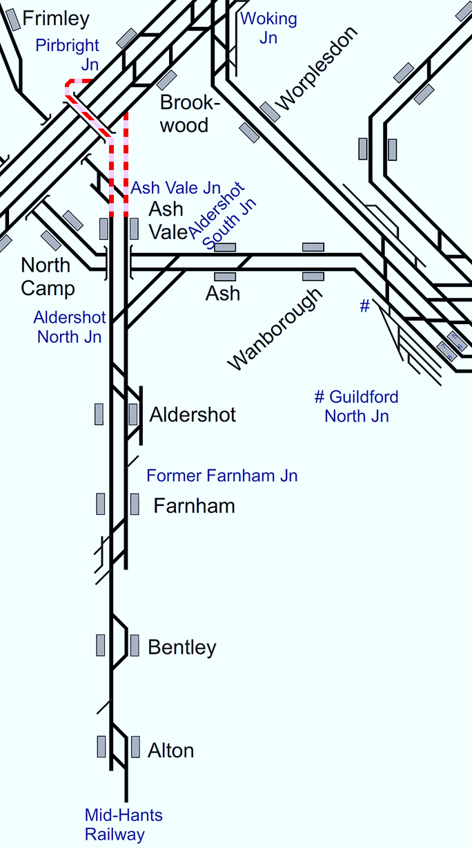
Plan 28.2 Pirbright Junction - Ash Vale
Alton Line | Status: One line blocked (in either direction)
Principles of Service Alteration
1Axx xx.23/53 Waterloo - Alton & return services run via Guildford and call additionally at Wanborough and Ash in affected direction. 2Jxx Farnham - Guildford and return cancelled. .(Use Crew to pilot 1Axx service crewed by BV/WA/WM) Consider 2Lxx forming 2Lxx services at Waterloo and use BV crew accordingly. Note: BV/WA/WM crews have NO alternative route knowledge (WA/WM do have route knowledge to Woking to Guildford). If Country side of Block hold in Platforms. If running Down from London consider diverting to Basingstoke. Watch for crew changes at Farnham.
Alternative Passenger Journey
SWR Bus replacement Brookwood to Ash Vale and Aldershot (in blocked direction). 1Axx SSO Guildford, Wanborough and Ash for diverted service. Use 2Jxx crew as Pilot crew if required.
Information for Signallers
2Jxx cancel and send to Farnham Shed or hold at Guildford. 1Axx run via Guildford and call all stations, may require Pilot crew.
Additional Information for Station Staff
SWR Bus replacement to run Aldershot to Brookwood and return.
Passenger Information
Passengers from Brookwood to travel to Woking for trains to Aldershot and Ash Vale.

Slide 34
Ash Vale
Plan 29 | Ash Vale - Aldershot North Junction Alton Line
29.1 | Both lines blocked
29.2 | One line blocked | ✔

Slide 35
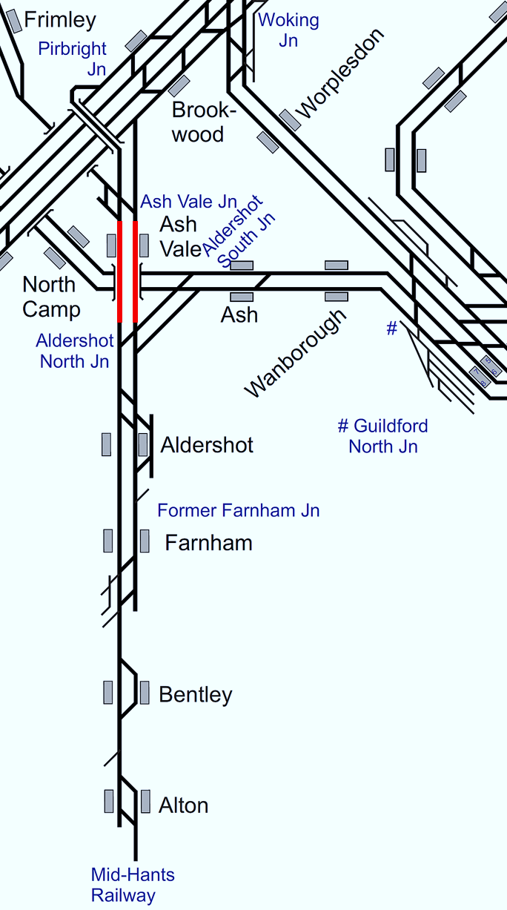
Plan 29.1 Ash Vale - Aldershot North Junction
Alton Line | Status: Both lines blocked
Principles of Service Alteration
1Axx xx.23/53 Waterloo - Alton & return services run via Guildford and call additionally at Wanborough and Ash. 2Nxx xx23/53 Ascot - Aldershot & return services cancelled. 2Jxx xx04/34 Farnham - Guildford & return services cancelled. .(Use Crew to pilot 1Axx service crewed by BV/WA/WM) Consider 2Lxx forming 2Lxx services at Waterloo and use BV crew accordingly. Note: BV/WA/WM crews have NO alternative route knowledge. (WA/WM do have route knowledge to Woking to Guildford). If Country side of Block hold in Platforms. If running Down from London consider diverting to Basingstoke. Watch for crew changes at Farnham.
Alternative Passenger Journey
SWR Bus replacement Aldershot to Ascot and Brookwood to Aldershot. 1Axx Alton to Waterloo and return via Guildford and call Guildford/Wanborough and Ash.
Information for Signallers
2N xx Ascot to Aldershot hold at Ascot 2Nxx Aldershot to Ascot send to Farnham shed. 2Jxx Farnham to Guildford and return Cancelled (hold at Farnham shed and Guildford). 1Axx Waterloo to Alton and return divert via Guildford (may require Pilot crew) Stop all stations.
Additional Information for Station Staff
SWR Bus replacement to run Aldershot to Ash vale and Brookwood and return. SWR Bus Replacement to run Aldershot to Ascot and return.
Passenger Information
Passengers from Brookwood to travel to Woking for trains to Aldershot. Passengers from Aldershot to Frimley and Camberley Bus 1 or 3, change to bus 34, 35 or 500 for Bagshot. Passengers from Bagshot to Camberley bus 34, 35 and Sunningdale bus 500, change for train to Ascot. Passengers from Ascot via Sunningdale station then 500 bus for Bagshot then bus 3 or Gold 1 to Camberley, Frimley, Ash Vale and Aldershot.

Slide 36

Plan 29.2 Ash Vale - Aldershot North Junction
Alton Line | Status: One line blocked (in either direction)
Principles of Service Alteration
1Axx xx.23/53 Waterloo - Alton & return services run via Guildford calling additionally at Wanborough and Ash in affected direction. 2Nxx xx 23/53 Ascot - Aldershot & return services cancelled. 2Jxx xx04/34 Farnham - Guildford & return services cancelled. Consider 2Lxx forming 2Lxx services at Waterloo and use BV crew accordingly. Note: BV/WA/WM crews have NO alternative route knowledge (WA/WM do have route knowledge to Woking to Guildford). If Country side of Block hold in Platforms. If running Down from London consider diverting to Basingstoke. Watch for crew changes at Farnham
Alternative Passenger Journey
SWR Bus replacement Aldershot to Ascot and Brookwood to Aldershot. 1Axx Alton to Waterloo and return via Guildford and call Guildford/Wanborough and Ash. (in Blocked direction).
Information for Signallers
2Nxx Ascot to Aldershot hold at Ascot 2Nxx Aldershot to Ascot send to Farnham shed. 2Jxx Farnham to Guildford and return Cancelled (hold at Farnham shed and Guildford). 1Axx Waterloo to Alton and return divert via Guildford (may require Pilot crew) Stop all stations (In blocked direction).
Additional Information for Station Staff
SWR Bus replacement to run Aldershot to Ash vale and Brookwood in blocked direction. SWR Bus Replacement to run Aldershot to Ascot and return.
Passenger Information
Passengers to/from Brookwood to travel to Woking for trains to Aldershot in blocked direction. Passengers from Aldershot to Frimley and Camberley Bus 1 or 3 change to bus 34, 35 or 500 for Bagshot. Passengers from Bagshot to Camberley bus 34, 35 and Sunningdale bus 500 change for train to Ascot. Passengers from Ascot via Sunningdale station then 500 bus for Bagshot then bus 3 or Gold 1 to Camberley, Frimley, Ash Vale and Aldershot.

Slide 37
Aldershot North Junction
Plan 30 | Aldershot North Junction - Aldershot Alton Line
30.1 | One or both lines blocked | ✔

Slide 38
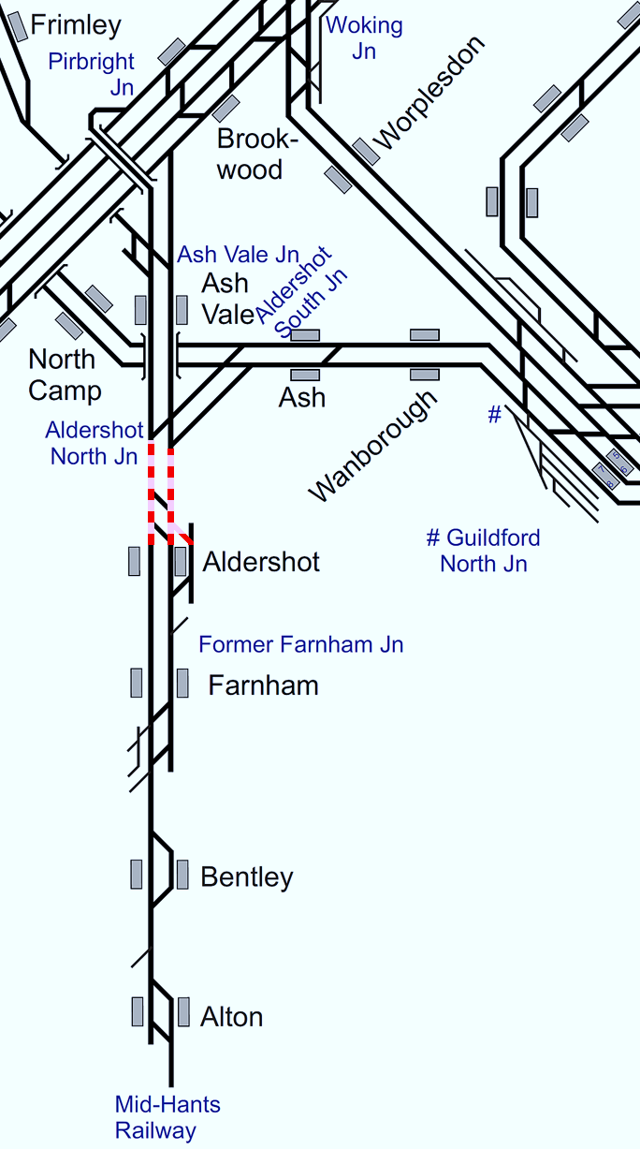
Plan 30.1 Aldershot North Junction - Aldershot
Alton Line | Status: One or both lines blocked
Principles of Service Alteration
1Axx xx.23/53 Waterloo - Alton & return services cancelled. 2Nxx xx00/30 Aldershot to Ascot & return services cancelled. 2Jxx xx04/34 Farnham to Guildford & return services cancelled. GWR: 2Vxx xx34 Redhill - Reading and 2Oxx xx04 Reading to Redhill SSO Wanborough. Hourly Shuttle service 1Zxx Aldershot to Alton and return.
Alternative Passenger Journey
SWR bus replacement Woking to Aldershot and Ascot to Guildford via Aldershot. GWR SSO Wanborough.
Information for Signallers
1Axx Alton to Waterloo terminate Aldershot to form Shuttle. Any surplus stock ECS to Farnham Shed. Any Down 1Axx Waterloo to Alton, Terminate Woking then Berth. if passed Woking divert to Basingstoke. 2Jxx Guildford to Farnham hold at Guildford or Terminate Ash run in service back to Guildford.
Additional Information for Station Staff
SWR Bus Replacement Aldershot to Ascot and return.
Passenger Information
Passengers from Aldershot to Frimley and Camberley Bus 1 or 3 change to bus 34, 35 or 500 for Bagshot. Passengers from Bagshot to Camberley bus 34, 35 and Sunningdale bus 500 change for train to Ascot. Passengers from Ascot via Sunningdale station then 500 bus for Bagshot then bus 3 or Gold 1 to Camberley, Frimley, Ash Vale and Aldershot.

Slide 39
Aldershot
Plan 31 | Aldershot - Farnham Alton Line
31.1 | Both lines blocked
31.2 | One line blocked

Slide 40
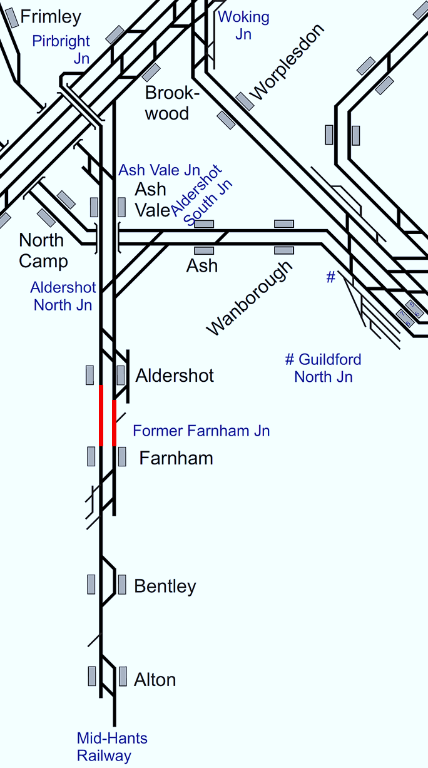
Plan 31.1 Aldershot - Farnham
Alton Line | Status: Both lines blocked
Principles of Service Alteration
1Axx xx.23/53 Waterloo - Alton & return services run to Aldershot. Hourly shuttle Farnham to Alton. 2Jxx xx23/53 Guildford to Farnham terminate/start Aldershot.
Alternative Passenger Journey
SWR bus replacement Aldershot to Farnham. Local buses.
Information for Signallers
1Zxx xx27/57 Farnham to Alton and return call at Bentley in both directions.
Additional Information for Station Staff
SWR bus replacement Aldershot to Alton.
Passenger Information
N/A.

Slide 41
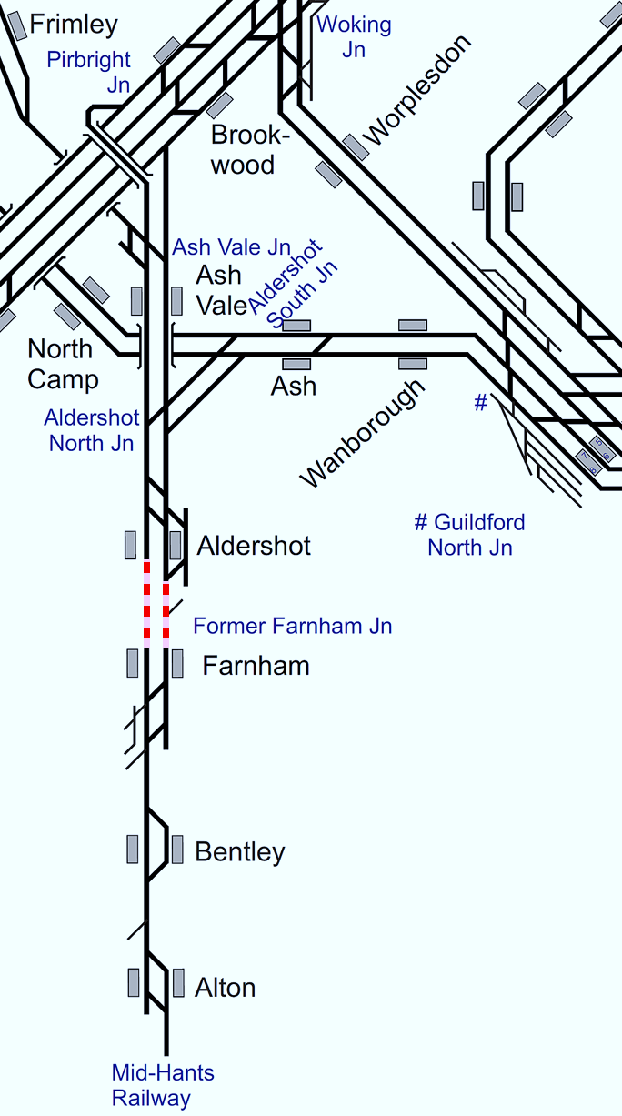
Plan 31.2 Aldershot - Farnham
Alton Line | Status: One line blocked (in either direction)
Principles of Service Alteration
1Axx xx.23/53 Waterloo - Alton & return services run to Aldershot. 1Zxx xx27/57 Farnham to Alton & 1Zxx xx14/44 Alton to Farnham shuttle. 2Jxx xx23/53 Guildford to Farnham terminate/start Aldershot.
Alternative Passenger Journey
SWR bus replacement Aldershot to Farnham. Local buses.
Information for Signallers
1Zxx xx27/57 Farnham to Alton and return call at Bentley in both directions.
Additional Information for Station Staff
SWR bus replacement Aldershot to Farnham.
Passenger Information
Local buses. Aldershot to Farnham and return buses 5, 17, 18, 18A, 19, 16 and 46.

Slide 42
Farnham
Plan 32 | Farnham - Bentley Alton Line
32.1 | Line blocked

Slide 43
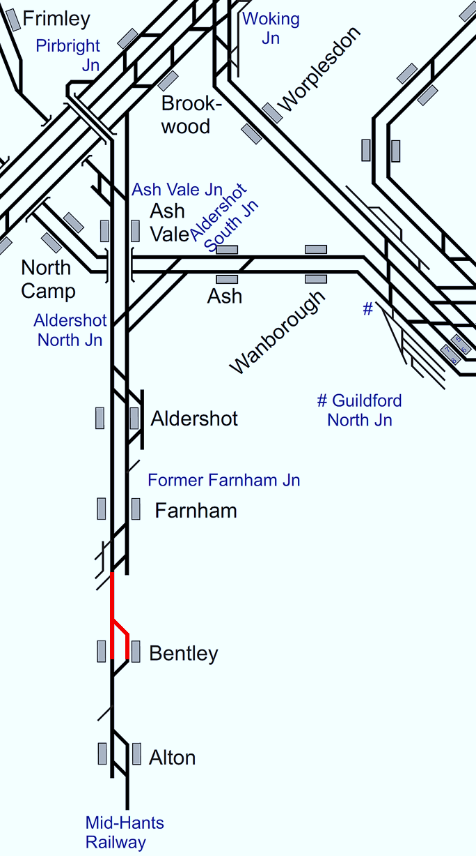
Plan 32.1 Farnham - Bentley
Alton Line | Status: Line blocked
Principles of Service Alteration
1Axx xx.23/53 Waterloo - Alton & return services run between Waterloo and Farnham.
Alternative Passenger Journey
SWR Bus Replacement Farnham to Alton Fast bus and Mini bus all stations to serve Bentley Local buses.
Information for Signallers
1Axx xx23/53 Waterloo to Alton terminate Farnham and Shunt to Shed for return Working 1Axx xx14/44 Alton to Waterloo depart xx28/58.
Additional Information for Station Staff
SWR Bus Replacement Farnham to Alton Fast bus and Mini bus all stations to serve Bentley.
Passenger Information
Passengers for Bentley and Alton bus 65. Five minute walk from station. Passengers at Bentley for Alton and Farnham. Station to Star Inn (bus stop) 1.1 miles, twenty minute walk then 65 bus to Farnham and Alton.

Slide 44
Bentley
Plan 33 | Bentley - Alton Alton Line
33.1 | Line blocked | ✔

Slide 45
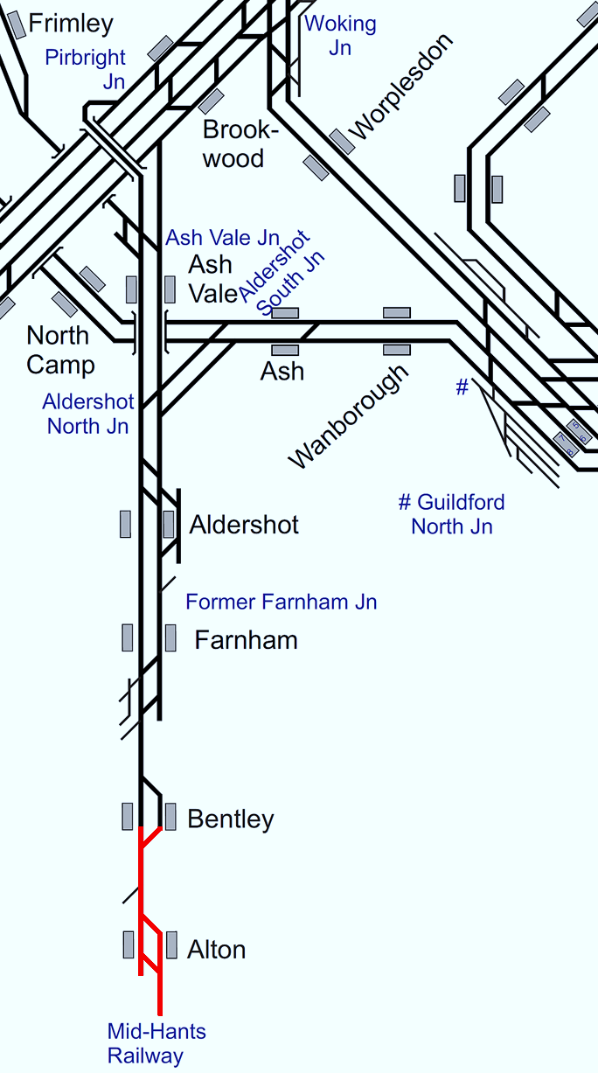
Plan 33.1 Bentley - Alton
Alton Line | Status: Line blocked
Principles of Service Alteration
1Axx xx.23/53 Waterloo - Alton & return services run between Waterloo and Farnham.
Alternative Passenger Journey
SWR Bus Replacement Farnham to Alton Fast bus and mini bus all stations to serve Bentley Local buses.
Information for Signallers
1Axx xx23/53 Waterloo to Alton terminate Farnham and Shunt to Shed for return Working. 1Axx xx14/44 Alton to Waterloo depart Farnham xx28/58.
Additional Information for Station Staff
SWR Bus Replacement Farnham to Alton Fast bus and Mini bus all stations to serve Bentley.
Passenger Information
Passengers for Bentley and Alton bus 65. Five minute walk from station. Passengers at Bentley for Alton and Farnham. Station to Star Inn (bus stop) 1.1 miles, twenty minute walk then 65 bus to Farnham and Alton.

